Slide 1









https://www.linkedin.com/in/edwardkwartler/
Side Hustles

Slide 2





If you are struggling ask for help.

Slide 3
The course uses three software components for learning.
In the next sections, skip to the method you want to use Local (Mac or Windows, Virtual Machine, Cloud/Hosted)
Integrated Development Environment
Version Control & file sharing
Statistical Software

Slide 4
3 Options for R, Rstudio & git
Local Laptop
GSERM VM
Cloud
OS:
Mac
Linux/Ubuntu
Windows
OS:
Windows 10
OS:
Linux/Ubuntu is most popular
You can use a free account at www.rstudio.cloud for the course.

Slide 5
3 Options for R, Rstudio & git
Local Laptop
GSERM VM
Cloud
Considerations:
Limited to RAM on laptop
No troubleshooting by prof
Considerations:
4Gbs RAM
Latency
Troubleshooting from school
Considerations:
RAM is scalable
Cost
Requires technical fluency to set up (command line)
Troubleshooting from prof

Slide 6
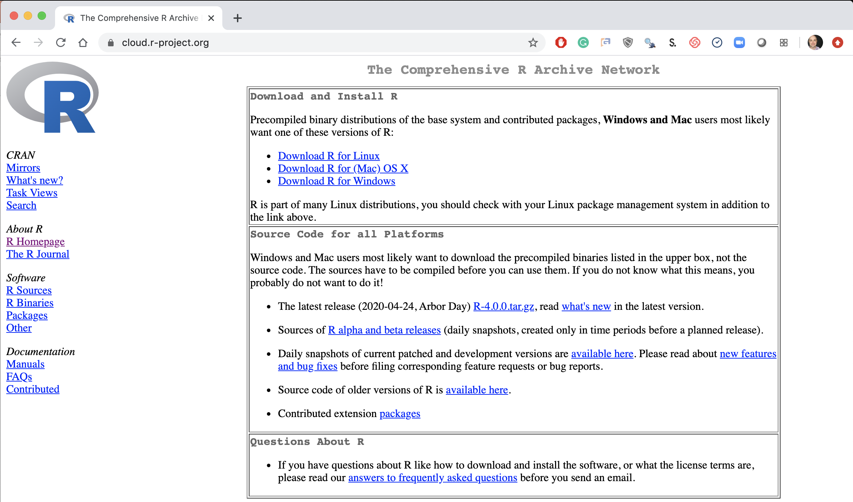
Step 1. Install Base -R
Local Laptop – Windows or Mac
Download the appropriate version Linux, Mac or Windows.
https://cloud.r-project.org/

Slide 7
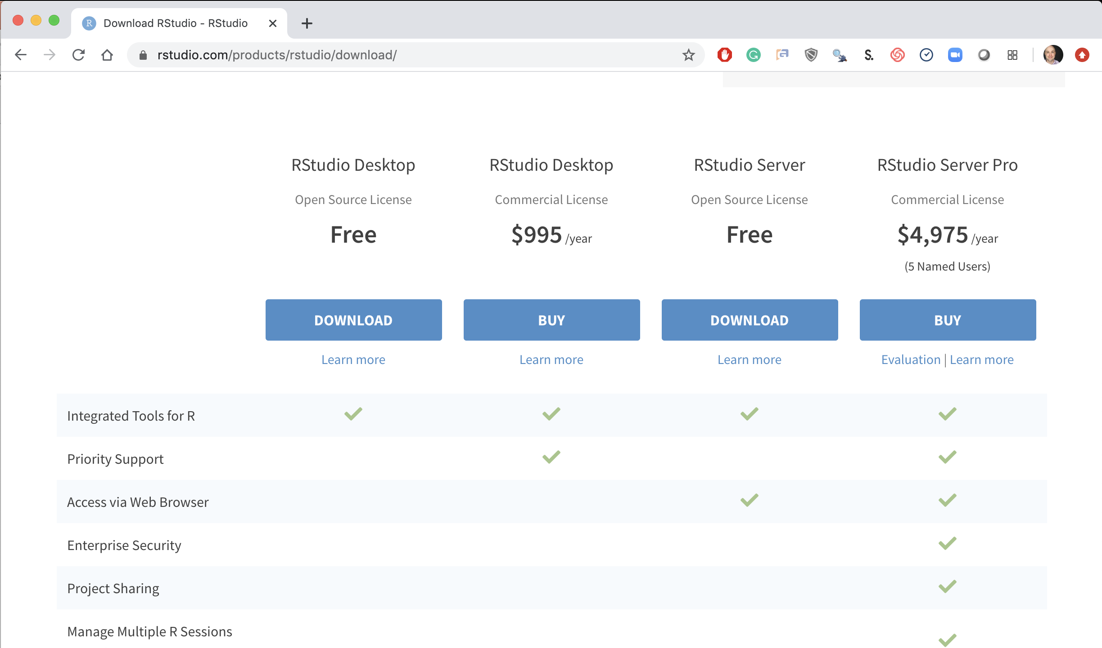
Step 2. Install R-Studio
Local Laptop Windows or Mac
Download the R Studio Desktop (Free).
https://rstudio.com/products/rstudio/download/ &
https://rstudio.com/products/rstudio/download/#download

Slide 8
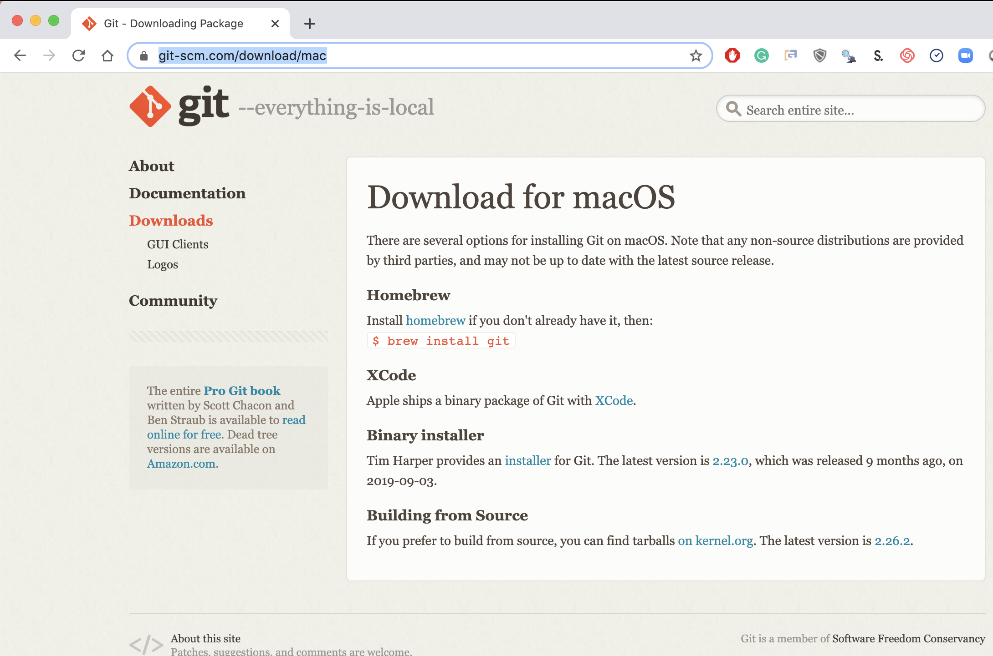
Step 3. Install Git (Mac)
Local Laptop Apple
Download the Git Program, then follow prompts for installation.
https://git-scm.com/download/mac &
https://www.youtube.com/watch?v=twFo9wCpdSU

Slide 9
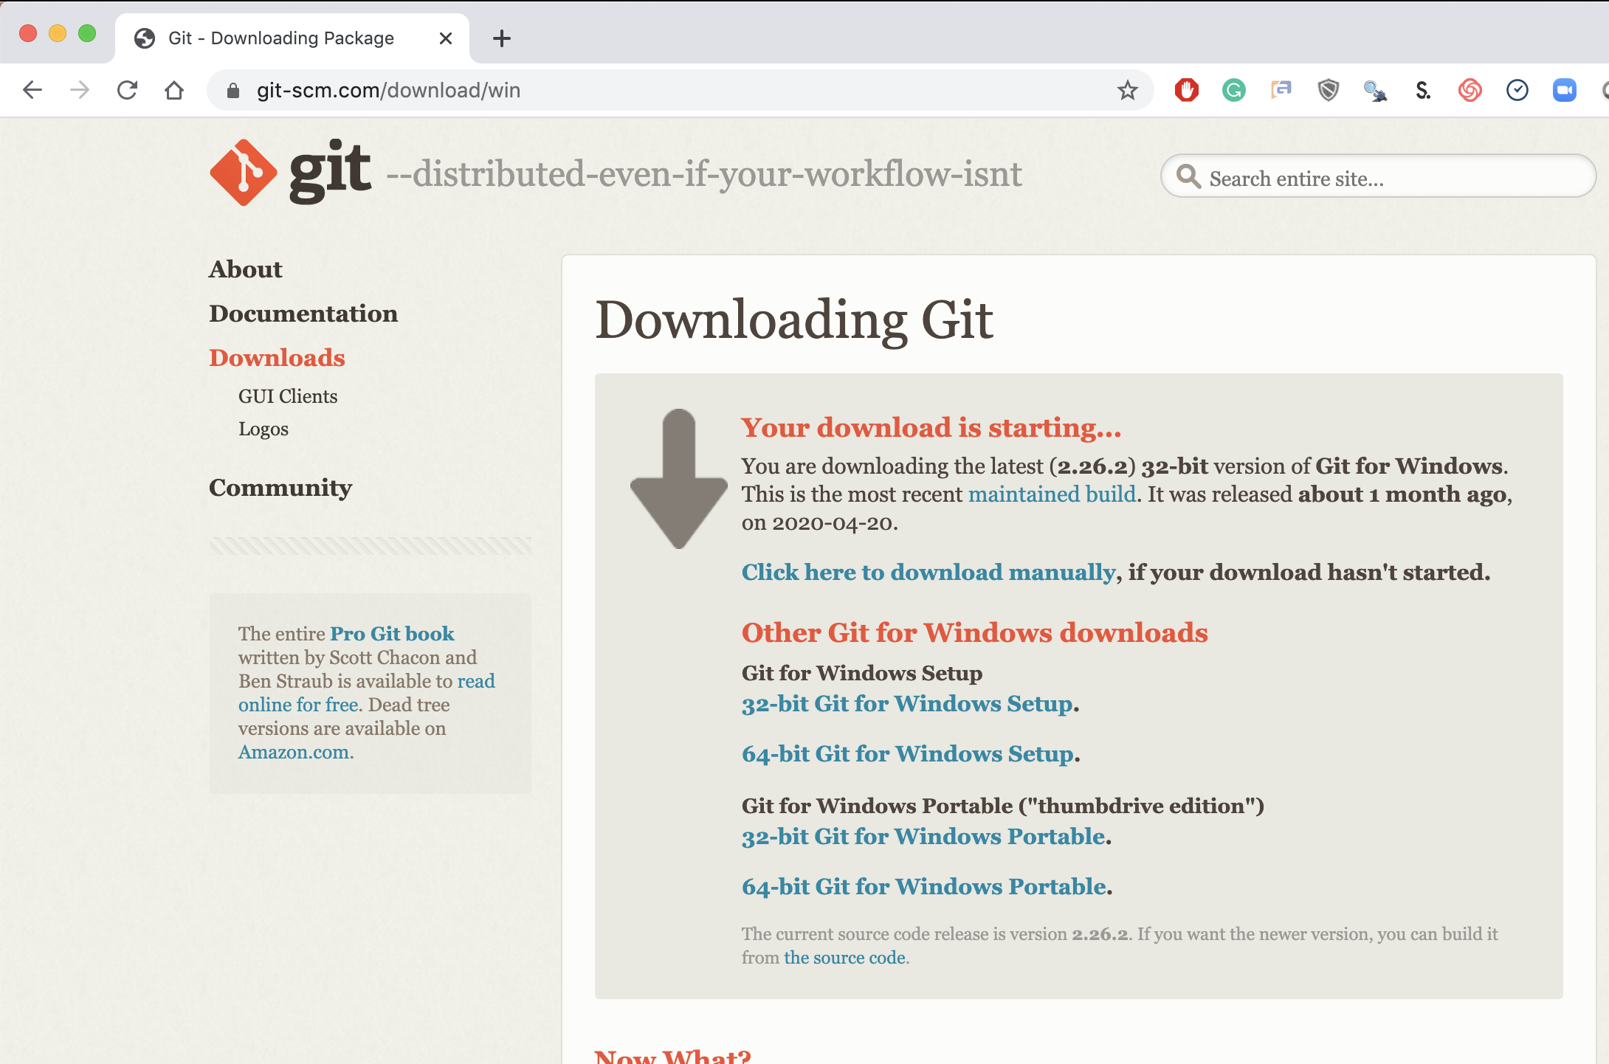
Step 3. Install Git (Windows)
Local Laptop MSFT
Download the Git Program, then follow prompts for installation.
https://git-scm.com/download/win &
https://www.youtube.com/watch?v=nbFwejIsHlY

Slide 10
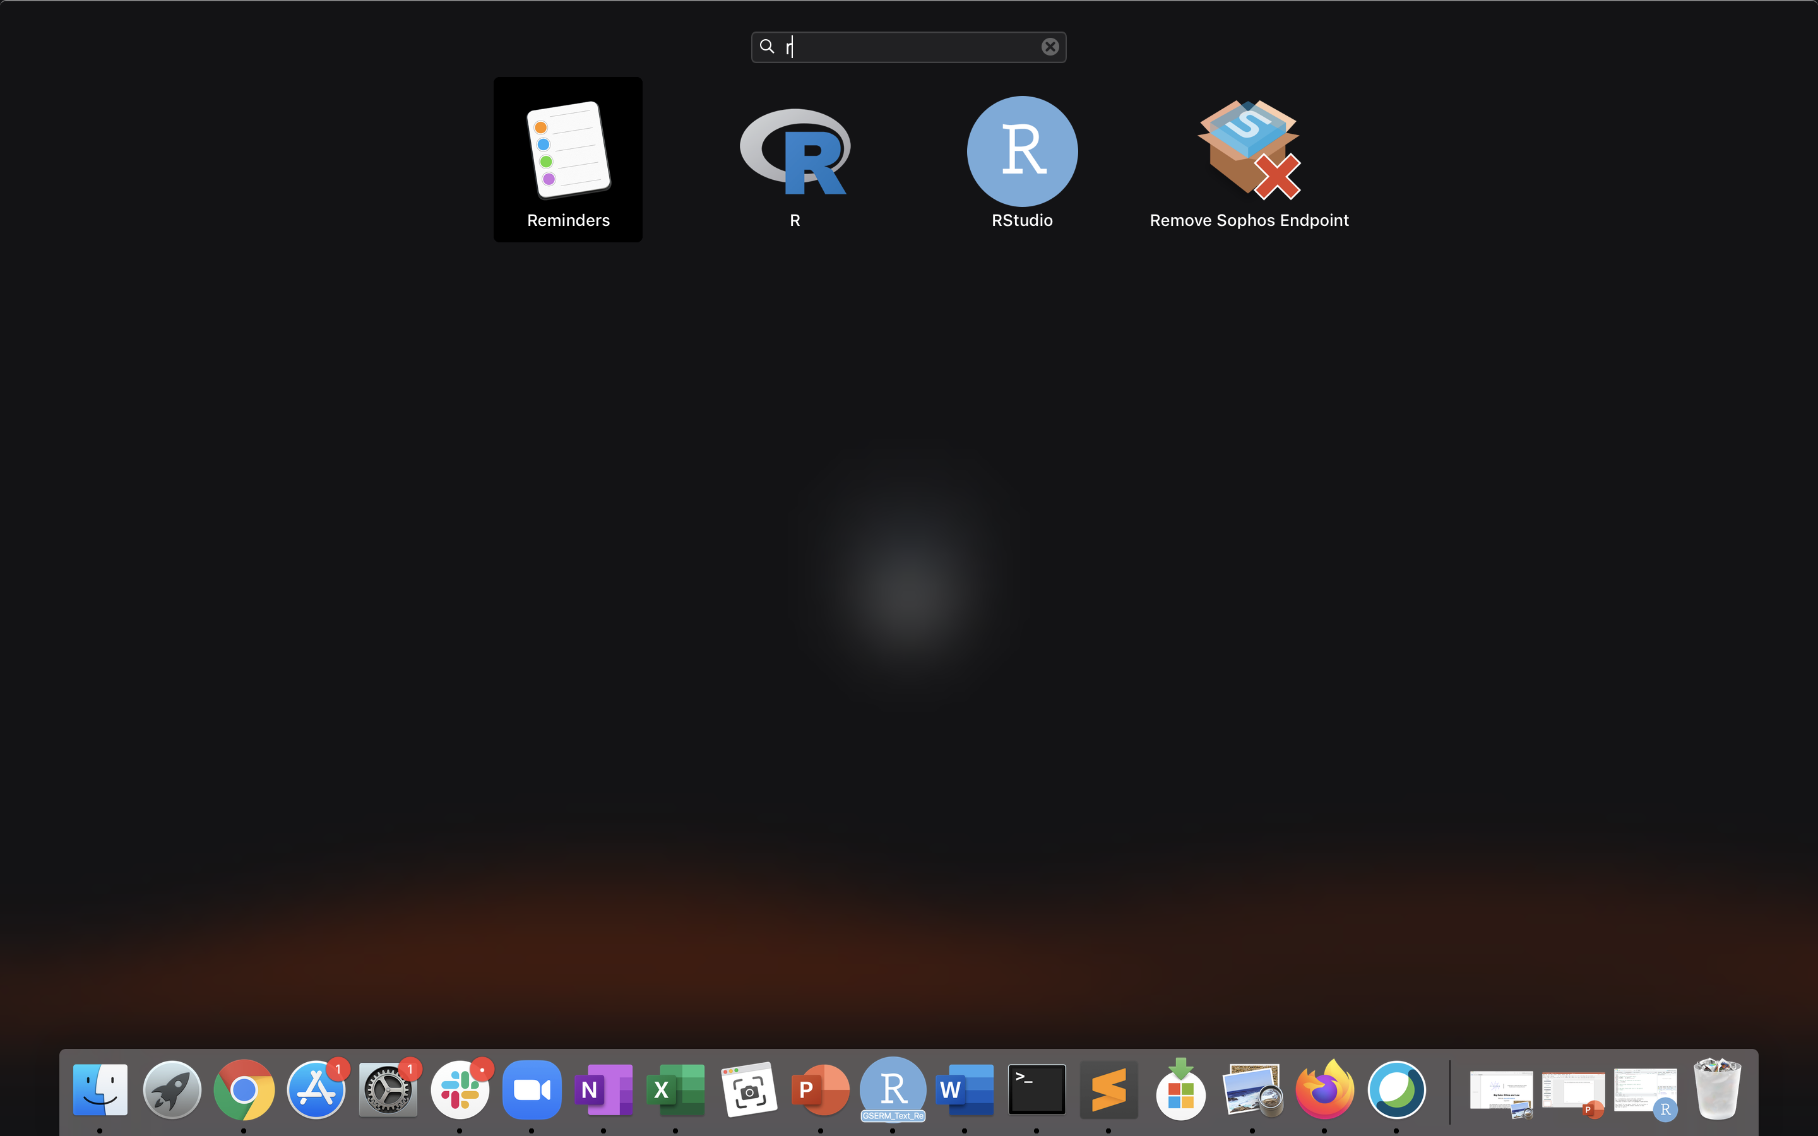
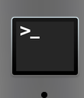
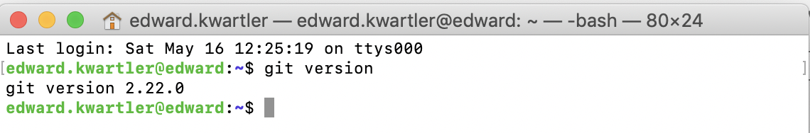
If you are working local you should now have R, R-Studio and git.
Mac: Use “Launchpad” & Type R
Mac: Use: “Terminal” & Type “git version”
Mac: Look for R and R-Studio Icons.

Slide 11
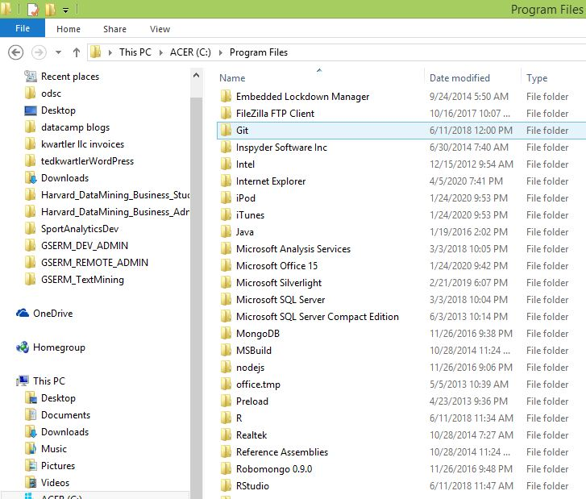
If you are working local you should now have R, R-Studio and git.
Windows: Navigate to the program folder look for git, R and R Studio

Slide 12
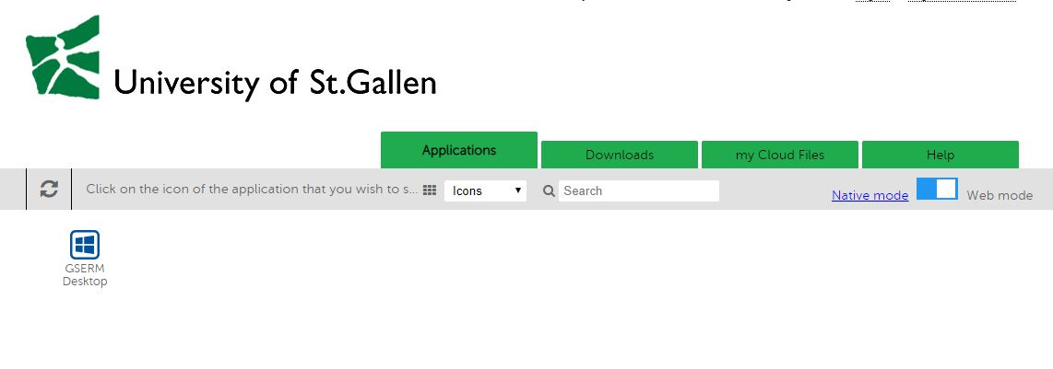
Steps 1 & 2 are done for you!
GSERM Virtual Machine (VM)
The school provided login credentials. Just enable “web mode” and click GSERM Desktop.

Slide 13
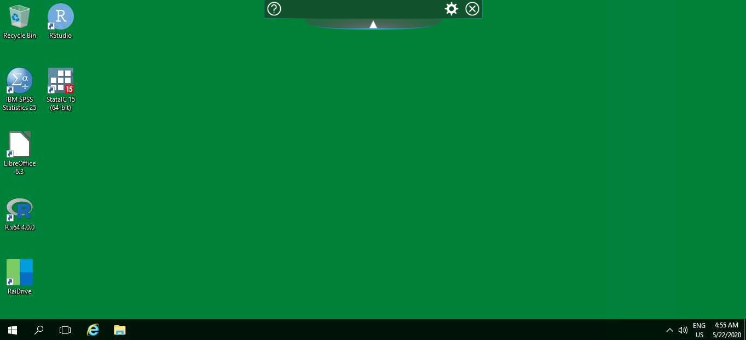
Steps 1 & 2 are done for you.
GSERM Virtual Machine (VM)
The VM already has R & R-Studio but you still need Git!

Slide 14
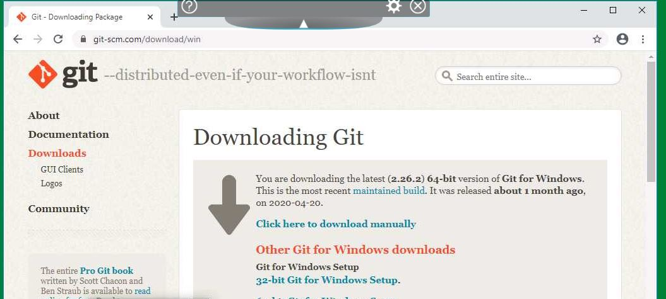
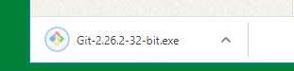
Step 3 Install Git
GSERM Virtual Machine (VM)
Open a browser, navigate to https://git-scm.com/download/win &
download the .exe

Slide 15
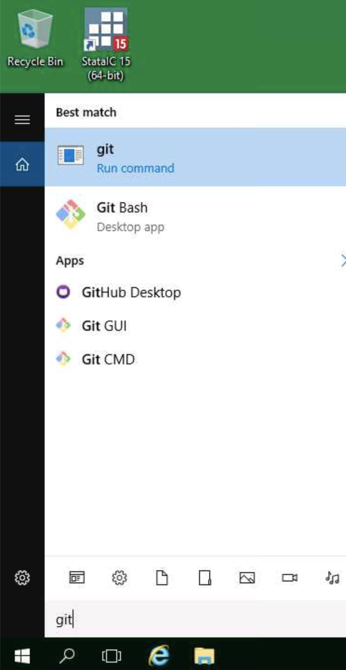
Verify you followed prompts correctly.
GSERM Virtual Machine (VM)
Just make sure at least this one appears!
Click the Search icon, lower left and type “git”.
You should see Git icons.

Slide 16
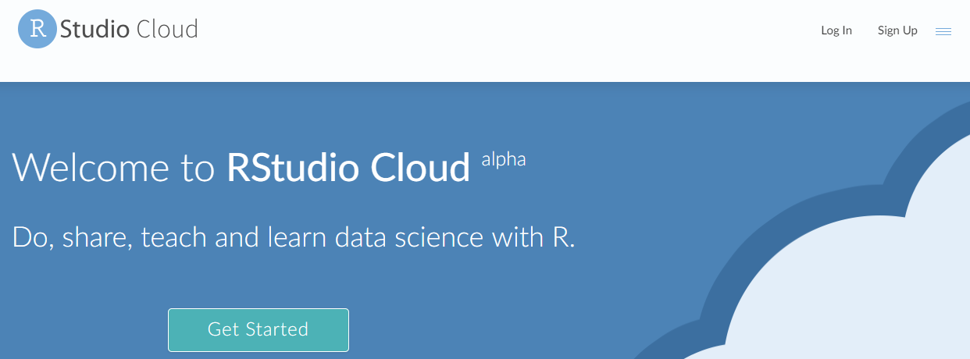
Easiest for this class…free hosted cloud instance
Sign up at:
https://rstudio.cloud/

Slide 17
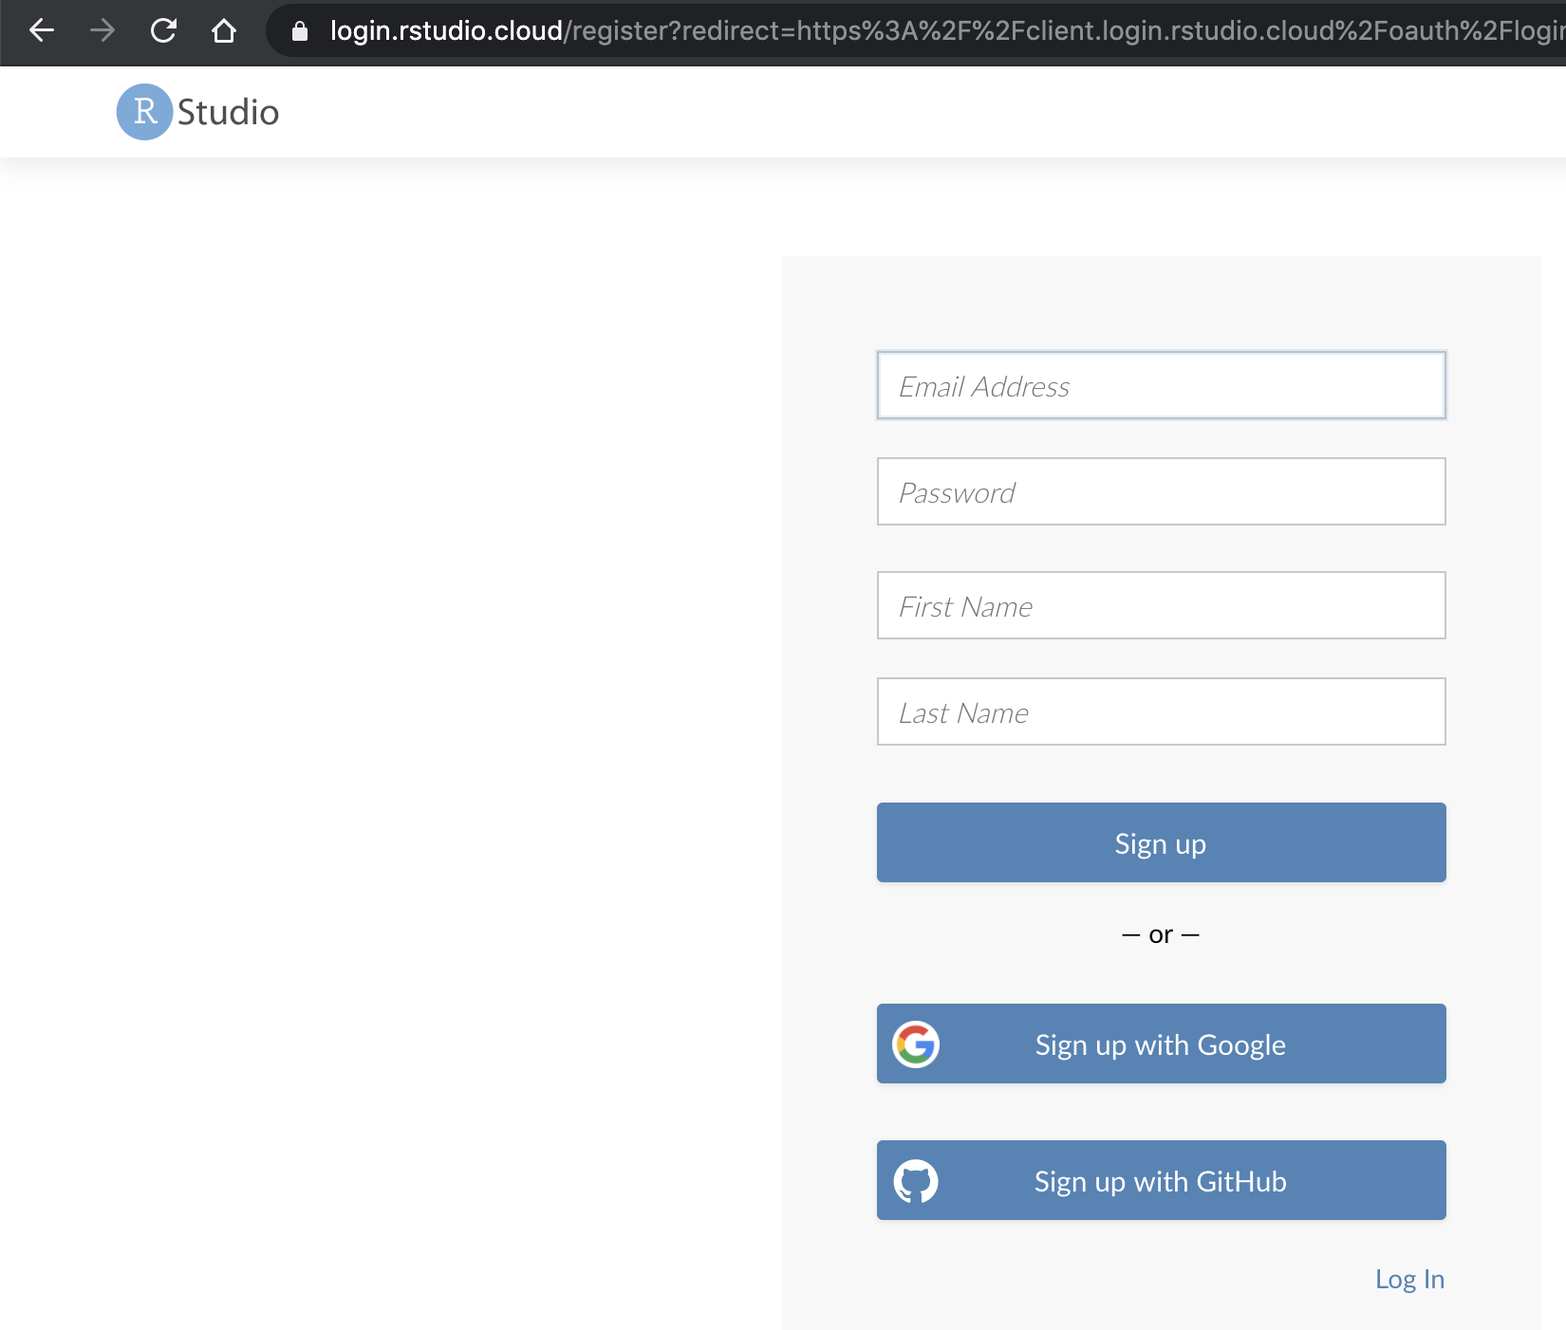
Steps 1, 2 & 3 are done for www.rstudio.cloud!
Cloud
Navigate to www.rstudio.cloud & sign-up!

Slide 18
Now that you have R, R-Studio & Git, time to connect to our class repository.
Connect to git repository.
R Studio sits on top of base R & adds functionality.
Class Files hosted on github.com
Makes the programmatic connection.

Slide 19
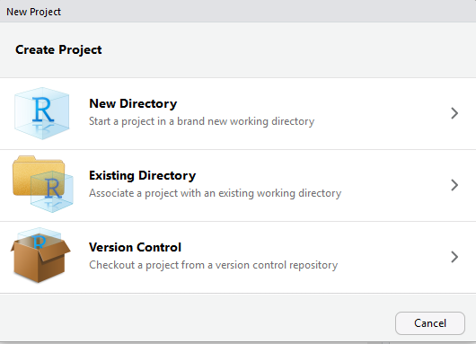
If LOCAL or VM: setup a new project & do a “git pull”
https://github.com/kwartler/GSERM_Text_Remote_student
Open R Studio
File
New Project
Version Control

Slide 20
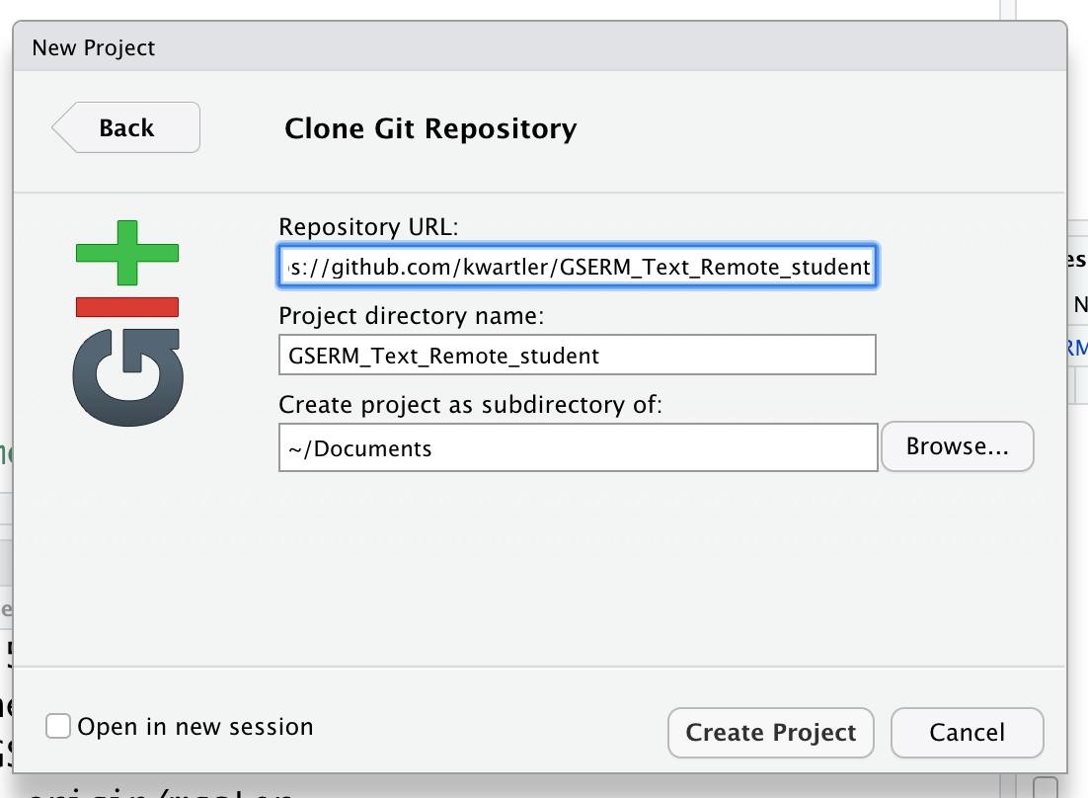
If LOCAL or VM: setup a new project & do a “git pull”
https://github.com/kwartler/GSERM_Text_Remote_student
In R Studio
File
New Project…
Version Control
Select Git
Add URL, folder name & destination for files

Slide 21
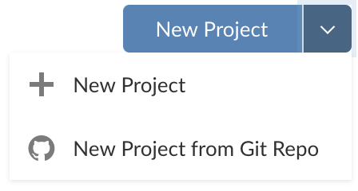
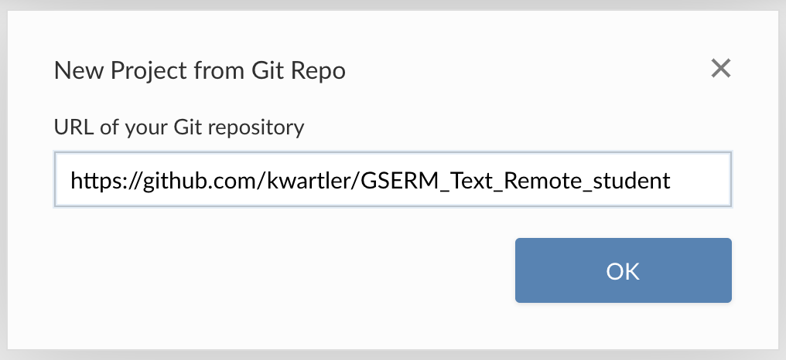
If you are using Rstudio.cloud
In the browser

Slide 22
Then rename your project in the browser
In the browser

Slide 23
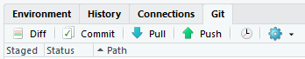
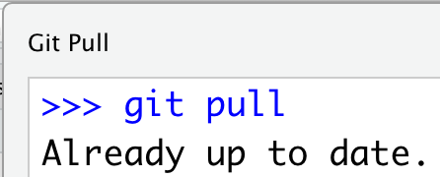
Each day we will perform a git pull.
https://github.com/kwartler/GSERM_Text_Remote_student
In R Studio
File
New Project…
Version Control
Select Git
Add URL, folder name & destination for files
EACH Class session perform a Git Pull to update files

Slide 24
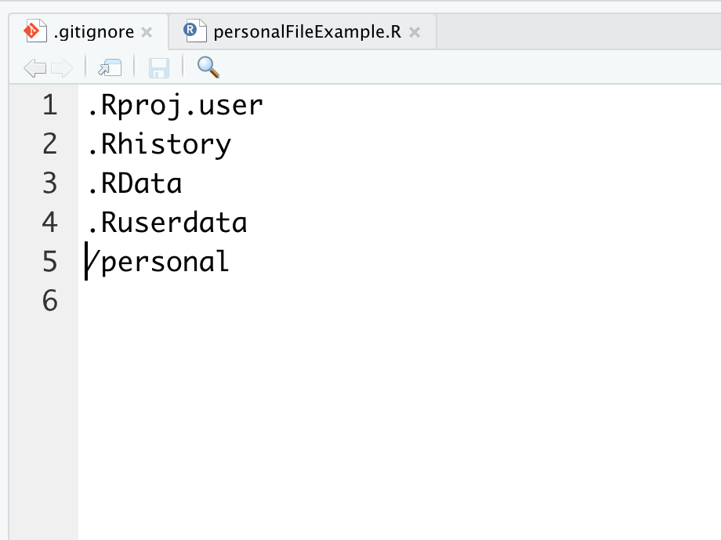
Second to last item. Create a personal folder.
Open the “gitignore” file. Add slash personal
Name of folder to be ignored “personal”
When you work and make changes to scripts, SAVE AS to a personal folder that is ignored by git.

Slide 25
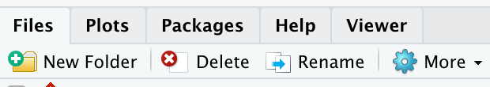
Second to last item. Create a personal folder.
In the lower right file section click “New Folder”. Name it “personal” exactly as in the gitignore (capitalization)
Click New Folder

Slide 26
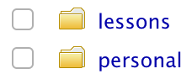
Second to last item. Create a personal folder.
In the lower right file section click “New Folder”. Name it “personal” exactly as in the gitignore (capitalization)
Any file you change should be “Save As” in this folder.

Slide 27
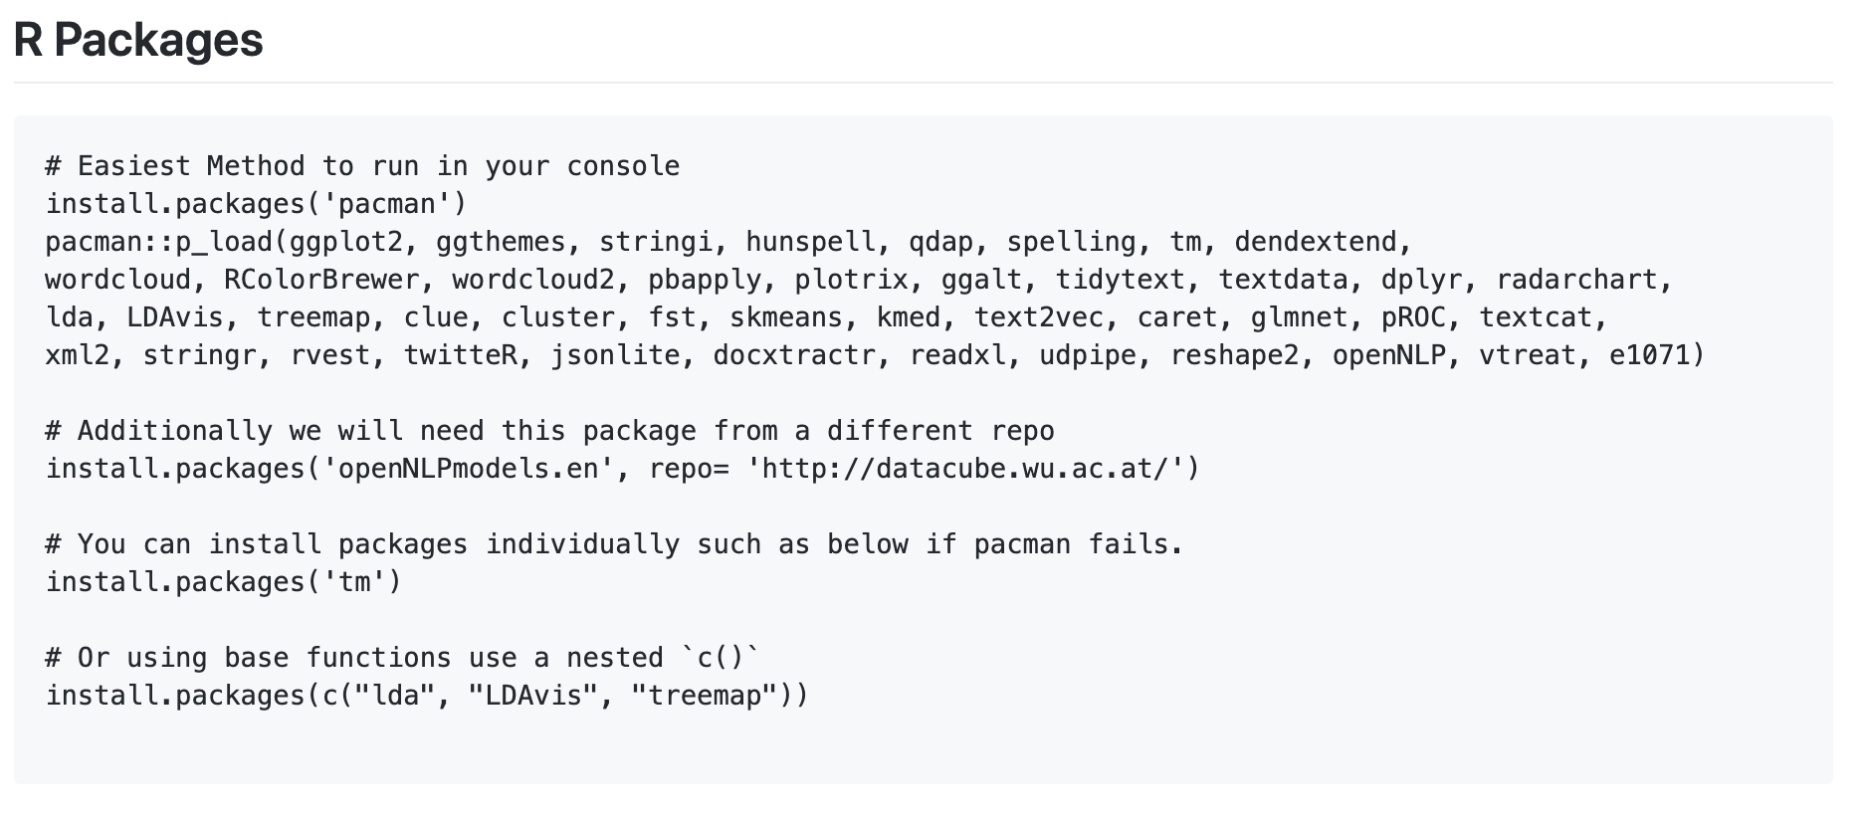
Now just run some code (we will explain it later)
https://github.com/kwartler/GSERM_Text_Remote_student
If you have R, Rstudio, Git, then made a connection and can run this code…you’re off to a great start! And don’t worry if you hit a hiccup, we will figure it out or work with the school on troubleshooting.

Slide 28
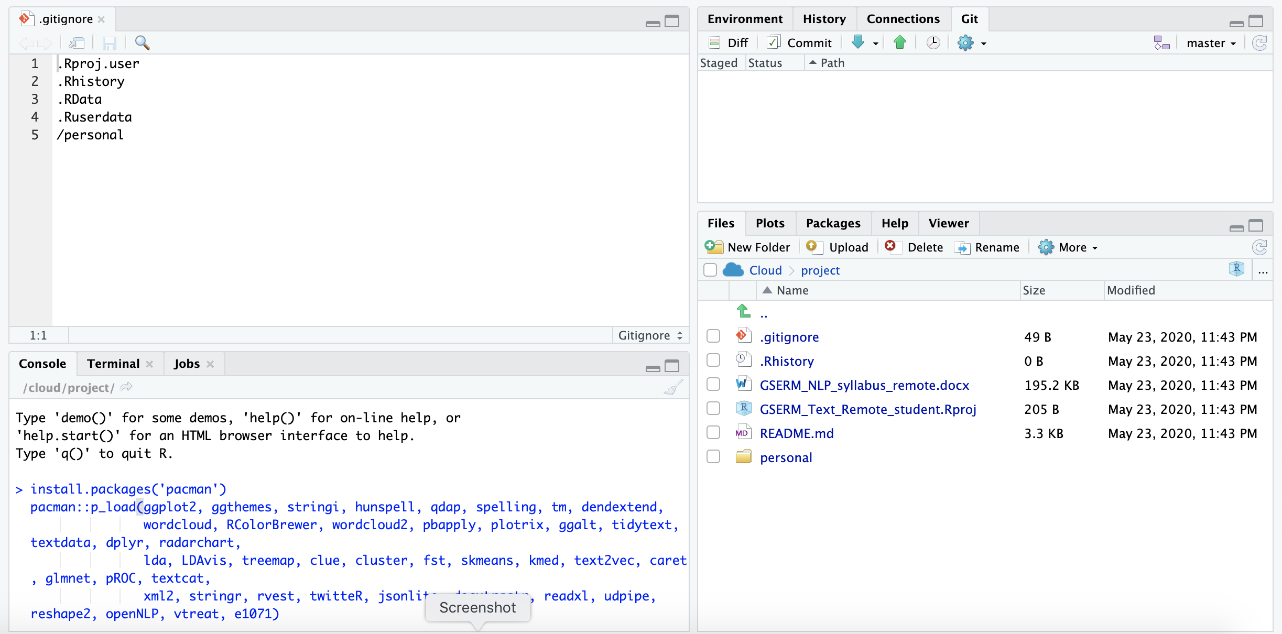
Now just run some code (we will explain it later)
Copy the first part of the code from the class repository. Then paste it into the “console” (lower left of your R session) & hit enter..
Do this step at a time when you don’t need your laptop, VM or can just leave your browser open depending on your method of accessing the software.

Slide 29
Almost setup…don’t worry if you need help live.

